Slide 1

Spring & Spring Boot

Slide 2
Framework ?
A framework in programming is essentially a pre-built structure that helps developers create software applications more efficiently.

Slide 3
Spring Framework
Java Framework
It provides a comprehensive and powerful toolkit for building enterprise-grade Java applications
Spring handles the infrastructure so you can focus on your application.
Dependency Injection and Inversion of Control

Slide 4
Spring Offers
Inversion of Control (IoC) and Dependency Injection: Spring manages these dependencies and injects them into objects as needed. This improves loose coupling and testability of code.
Data Access: Spring simplifies interacting with databases through features like JDBC abstraction and integration with Object-Relational Mapping (ORM) tools like Hibernate.
Web Development: Spring provides frameworks like Spring MVC and Spring WebFlux for building robust and scalable web applications following the Model-View-Controller (MVC) design pattern.
Other Features: Spring offers a vast range of additional features including support for testing, messaging, security, caching, and more.

Slide 5
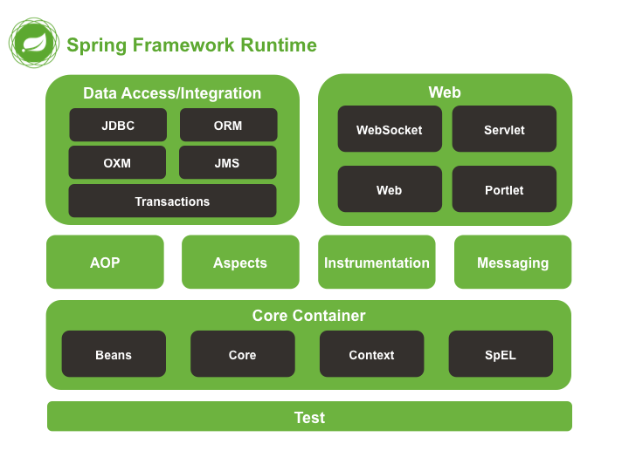
Spring Framework Modules

Slide 6
Dependency Injection
Injecting objects by other objects
Injecting objects using IOC[spring container]
Using xml
Using annotations
@Bean
@Component

Slide 7
Dependency Injection
Constructor Injection
This approach involves injecting dependencies through the constructor of a bean.
Setter Injection:
This approach involves injecting dependencies through setter methods of a bean.
Field Injection
Field injection involves marking a bean's fields with the @Autowired annotation. Spring will then attempt to inject a compatible bean during object creation by reflecting on the fields.

Slide 8
Spring Boot
Built on the top of Spring Framework.
designed to simplify the development of Java applications.
It addresses the issue of development complexity and boilerplate code that can be a hurdle in traditional Spring development.
Reduced Boilerplate:
Autoconfiguration
Automatic Dependency Management
Server Integration
Faster Development(RAD)
Improved Developer Experience
Simplified Production Deployment:
Etc.

Slide 9
Dependency Injection
Working with same type of beans
Qualifier,@Primary, @Scope
Loose coupling concepts
@ImportResource("classpath:config.xml")

Slide 10
Beans Scopes
Singleton: Default) Scopes a single bean definition to a single object instance for each Spring IoC container
Prototype: Scopes a single bean definition to any number of object instances.
Request: Scopes a single bean definition to the lifecycle of a single HTTP request. That is, each HTTP request has its own instance of a bean created off the back of a single bean definition. Only valid in the context of a web-aware Spring ApplicationContext.
Session: Scopes a single bean definition to the lifecycle of an HTTP Session. Only valid in the context of a web-aware Spring ApplicationContext.
Application: Scopes a single bean definition to the lifecycle of a ServletContext. Only valid in the context of a web-aware Spriang ApplicationContext.
Websocket:Scopes a single bean definition to the lifecycle of a WebSocket. Only valid in the context of a web-aware Spring ApplicationContex

Slide 11
References
https://docs.spring.io/spring-framework/reference/core/beans/factory-scopes.html

Slide 12
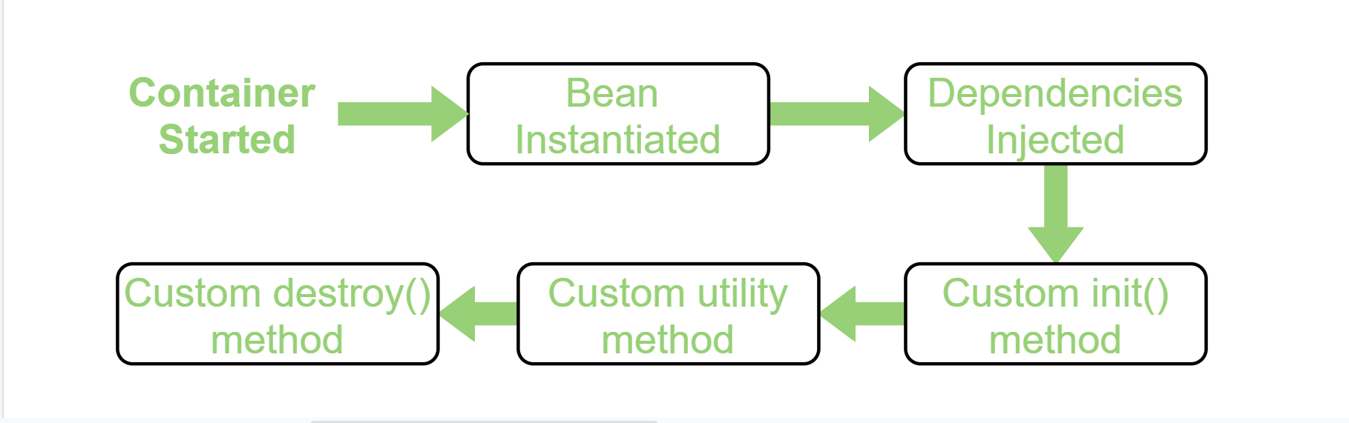
Beans Lifecycle
Stages a bean goes through, from its creation to its eventual destruction.
This lifecycle is managed by the Spring container (BeanFactory) to ensure beans are properly initialized, used, and cleaned up.

Slide 13
Implementing Bean Lifecycle
Use InitializingBean interface and override afterPropertiesSet() method for initializing purpose or use @PostConstruct annotation.
Use DisposableBean interface and override destroy () method for initializing purpose or use @PreDestroy annotation.

Slide 14
AOP with Spring Boot

Slide 15
AOP
Aspect-Oriented Programming (AOP) is a programming technique that helps you organize code by separating concerns.
Imagine a program with functionality for managing users (core logic). AOP allows you to separate aspects like logging, security, and error handling from this core logic. These are considered "cross-cutting concerns" because they affect multiple parts of the codebase
AOP is a powerful technique for improving code modularity, maintainability, and reusability.

Slide 16
Benefits of AOP
Cleaner Code:By isolating concerns, your core logic becomes more focused and easier to understand.
Easier Maintenance:If you need to change logging or security, you only modify the aspect code, not the core logic.
Improved Reusability:Code for common concerns like logging can be reused across different parts of the program.

Slide 17
Concepts
Aspect: An aspect is a class that encapsulates a cross-cutting concern like logging, security, or transaction management. It defines the advice (what to do) and pointcut (where to do it).
Advice: Advice is the actual code that gets executed at specific points in your application's execution.
@Before: Advice executed before a method is called.
@After: Advice executed after a method is called, regardless of whether it throws an exception.
@AfterReturning: Advice executed after a method returns successfully.
@AfterThrowing: Advice executed after a method throws an exception.
@Around: The most powerful advice type. It surrounds the method execution, allowing you to control the method call and potentially modify the return value or throw an exception.

Slide 18
Concepts
Pointcut: A pointcut is an expression that defines where the advice should be applied in your code. Spring AOP offers pointcut expressions to target specific methods, method arguments, or execution types.
JoinPoint: A point in your application's execution where an aspect can be applied. This could be a method call, field access, or exception throw.

